Slide 1
Data Analysis Group (Audit Group 30) and TCA Experience

Slide 2
Content of Presentation
Data Analysis Group and Its Activities
Collection of Data from Auditees
VERA
Risk Assessment System
Analysis Scenarios
Dynamic Analysis
Statistical Sampling Implementations
Vision

Slide 3
Data Analysis Group and Its Activities
Data Analysis Group
examines, transforms, models and evaluates data
to
report conclusions,
discover useful information
and support decision making.

Slide 4
Data Analysis Group and Its Activities
Before 2017, auditors were using different softwares, such as ACL, Access etc., to analyse data.
In June 2017 a new group, Data Analysis Group, was formed consisting of auditors who have IT experience.

Slide 5
Data Analysis Group and Its Activities
The mission of Data Analysis Group
to design a methodology for using computerised audit systems
to improve the implementation of computer assisted audit techniques into the auditing process

Slide 6
Data Analysis Group and Its Activities
Activities
to identify activities required to perform computer assisted audit in TCA as work packages
to create risk scenarios to assist in the assessment of risk among municipalities
to prepare computer assisted audit scenarios for accounting data and for the control of electronic payroll system

Slide 7
Data Analysis Group and Its Activities
Aims
to lessen the resources used and decrease workload
to examine big amounts of data completely
to identify mistakes or errors in data processing on an earlier step
to enable automation of analysis and continuous monitoring

Slide 8
Collection of Data from Auditees
Definition of data sets and the format of the data sets that has to be prepared by the auditees to be submitted and the way of submission are defined by TCA.
The data and other information of auditees within the scope of the central government are kept electronically by Ministry of Treasury and Finance.
The transmission of data is carried out over a secure connection.

Slide 9
Collection of Data from Auditees
A system called ‘BVAS’ is developed which enables municipalities to transfer their data over a form based smart client application securely.
The system is user friendly and controls the data format before it is uploaded. The system has been operational since 2017 and by 2018 over 1250 municipalities have successfully started using this system and securely uploading their data to the system.

Slide 10
VERA
VERA stands for ‘Turkish Court of Accounts Data Analysis and Business Intelligence System’ .
All auditors have access to VERA and they can reach financial data and analysis results of the public bodies they are auditing via it.

Slide 11
VERA
VERA is a centralized and web based system, the data is being kept in data warehouse.
The auditors are accessing the data via the system independent of their current location by using VPN (secure internet connection).
The new system puts no limits to the size or dimension of the data and that brings easiness while collecting, managing or analysing big data.

Slide 12
DATA
DATA
DATA
Central Government+ Revolving Fund
IPFMS
WEB-PORTAL
KBS - DMİS
VERA
SCENARIO
ANALYSIS
TURKISH COURT of ACCOUNTS
Municipalities
WEB-PORTAL
Special Provincial Administrations
WEB-PORTAL
Social Security Institutions
WEB-PORTAL
ETL
ACCOUNTING
ACCRUAL
CUSTODY
PAYROLL
TAX
BUDGET
PAYMENT
ADVANCE
IMMOVABLE
MOVABLE
PROPERTIES
PEE - Company
WEB-PORTAL
Others
DATA WAREHOUSE
WEB-PORTAL
Notes:
Şu anda yalnızca Belediyelerin ve bağlı idarelerin verilerini on-line olarak Sayıştay sistemine göndermelerini sağlayan Belediye Veri Alma Sisteminin bütün kamu idarelerini kapsayacak şekilde geliştirilmesi çalışmaları devam etmektedir.
2019 yılının ilk çeyreğinde bütün Kamu İdarelerinin, Kamu İdaresi Hesapları da dahil, her türlü elektronik veriyi on-line olarak ve güvenli bağlantıyla Sayıştay’a göndermelerinin sağlanması hedeflenmektedir.

Slide 13
Risk Assessment System and Analysis Scenarios
TCA aims to have a centralised data processing function by which the management will identify the risks earlier before the annual audit programming/planning process and set the audit strategy.
Also with development of predefined analysis scenarios, the data will be reviewed on a regular basis with respect to the predetermined parameters during the audit process.
Scenarios putted forward are in fact primary controls imposed by the management. The results will provide the auditors with an assurance to some degree about the veracity of the data. If they see it necessary further investigation will be done by auditors.

Slide 14
Risk Assessment System and Analysis Scenarios
Analysis scenarios that work on the data submitted by the auditees are designed to crosscheck a wide range of data sets and to detect risks and accounting errors.
Not only risk-detecting scenarios but also iterative and time taking procedures that fall upon the auditor while conducting audits are being identified and computerized.
All data in the data warehouse system is being controlled for both data integrity and compliance.

Slide 15
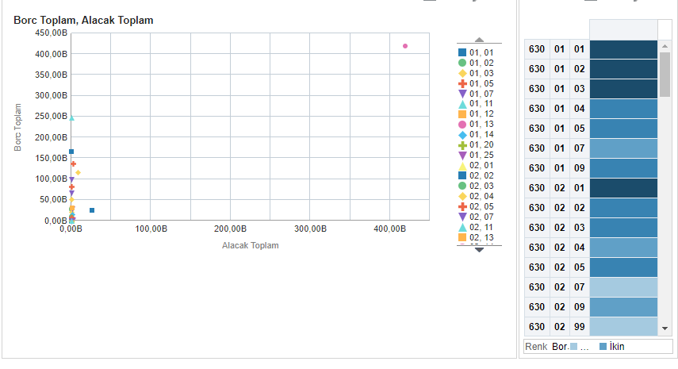
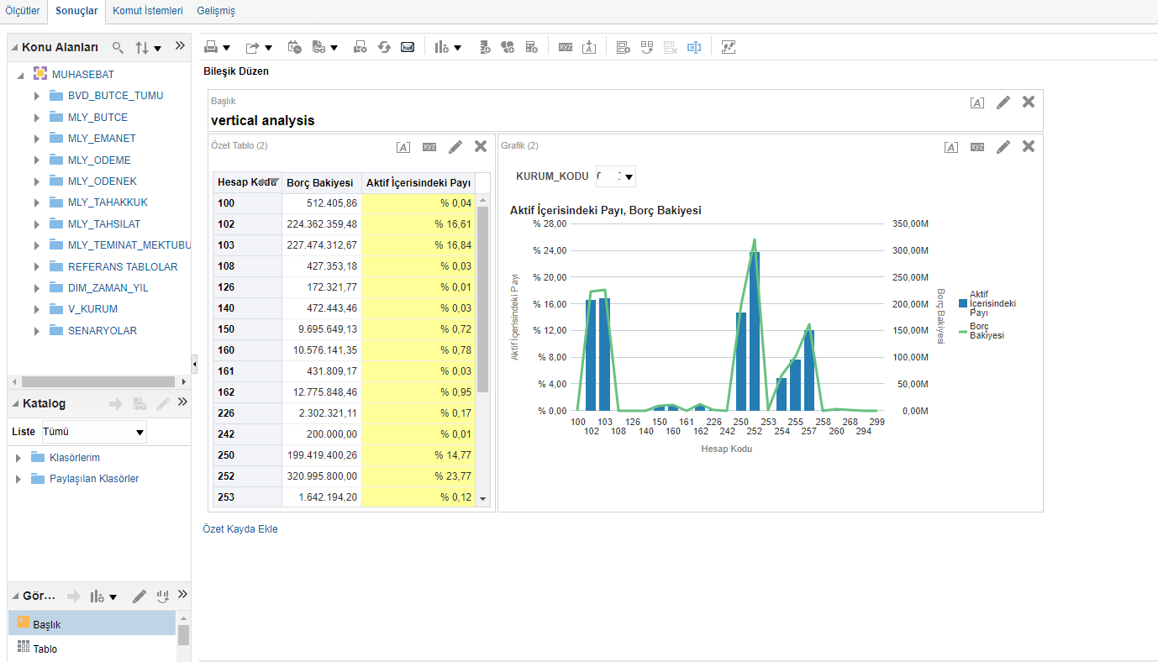
Risk Assessment System and Analysis Scenarios
Analysis on Financial Statements
Calculation of Balance Sheet Balances
Calculation of Income Statement Balances
Vertical and Horizontal Analyses

Slide 16
Risk Assessment System
Due to the risk criteria designed by the audit group 30, some municipalities can be classified as more risky.

Slide 17
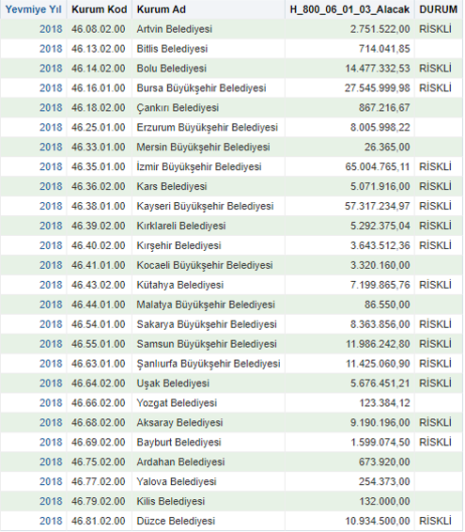
Risk Assessment System
For example, this scenario lists the building sales revenues of municipalities. Municipalities with higher income than other municipalities are classified as risky.

Slide 18
Risk Assessment System
It can be stated that the listed municipalities tend to sell their assets. So maybe they have financial difficulties because of higher expenses or lower income than they should be. As a result for this scenario, these municipalties can be more risky according to the others.
Of course, just one analysis cannot show that the municipality is risky.
There are 134 risk scenarios and as a result of each risk scenario, municipalities that are considered to be at high risk of error are given 1 point. At the end, municipalities with higher score are considered as more risky than others.

Slide 19
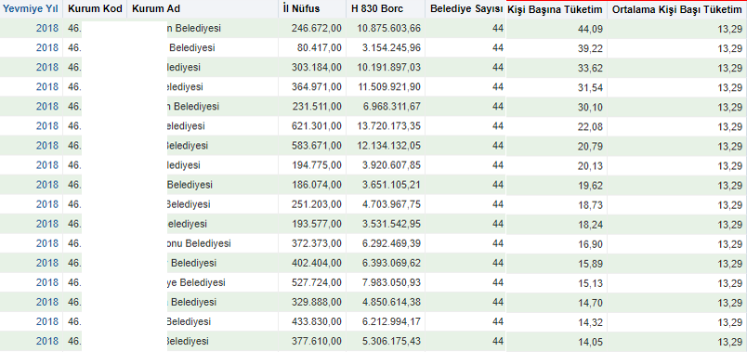
Risk Assessment System
In this scenario, municipalities with high fuel consumption according to the population they serve are listed.

Slide 20
Risk Assessment System

Slide 21
Risk Assessment System
These institutions are not listed due to illegal transactions. This scenario shows only the risk that the Authority may have been careless in its expenditures. There is a classification within the analysis itself and similar municipalities are compared with each other.
In addition, we also have risk scenarios that determine the existence of situations that are contrary to the regulations.

Slide 22
Risk Assessment System
For example, according to our regulations, the total personnel expense of a municipalty should not exceed 30% of the previous year's income. In this scenario, the municipalities that are inconsistent with the regulations are listed as risky.

Slide 23
Analysis Scenarios
Analysis on Accounting Journal Entries (risk based)
In such scenarios, although the accounting records are in compliance with the regulations, the records containing risk as the nature of the transaction are listed.

Slide 24
Risk Assessment System and Analysis Scenarios
# of Analysis on Accounting Journal Entries (as of April 2019)
 | Central Government Accounting Scenarios | Local Administrations Accounting Scenarios
Current Assets | 46 | 36
Fixed Assets | 36 | 35
Liabilities | 16 | 16
Equities | 2 | 1
Operating Accounts | 3 | 4
Budgetary Accounts | 2 | 1
Total | 105 | 93

Slide 25
Analysis Scenarios
In this scenario, deletion of the amounts recorded in the «receivables from persons account» with reversal or expense record is examined.

Slide 26
Analysis Scenarios
In the analysis table on the screen, the auditee seems to have deleted a total of 34,852,259,51 TL (approximately $ 6,336,774.46) receivables from persons with 4 different accounting records. While this situation may be appropriate, the auditor should examine the transaction and related documents in depth.
As a result of this analysis, a similar transaction was determined in 153/192 different institutions and the total amount of receivables deleted was determined as 249.107.113,05TL (approximately 45.292.202.37 $).
While planning phase, the auditor can choose whether to examine all the processes in this field or to conclude with the sample chosen by sample analysis which will be described later.
For example, a total of 880 records with a total of 75,274,382,01TL (approximately $ 13,686,251.27) was deleted and the auditor will be able to examine all of these 880 records or examine some of these records with sample analysis.

Slide 27
Analysis Scenarios
Analysis on Accounting Journal Entries (error based)
With these scenarios, incorrect transactions are identified from the accounting records or the summary tables generated.

Slide 28
Analysis Scenarios
If total value of depreciation is in orange color : It is understood that although there is an asset recorded in the asset group, there is no depreciation record.
If total value of depreciation is in red color : It is understood that there are more depreciation records in the asset group than the value of recorded assets.

Slide 29
Analysis Scenarios
Analysis on Personnel Payments
It covers checks on the accuracy of various elements of civil servant salaries. It is especially important to check the payments made on civil servants' declarations.

Slide 30
Analysis Scenarios
# of Analysis Scenarios on Personnel Payments (as of April 2019)
Analysis group | # of analyses
Social security wage cut controls | 9
Social rights payments controls | 6
Wage calculation controls | 9
Consistency controls (duplications, reference tables, years of seniority,…) | 22
Tax controls | 8
Additional payments and compensation payment controls | 17
Total | 71

Slide 31
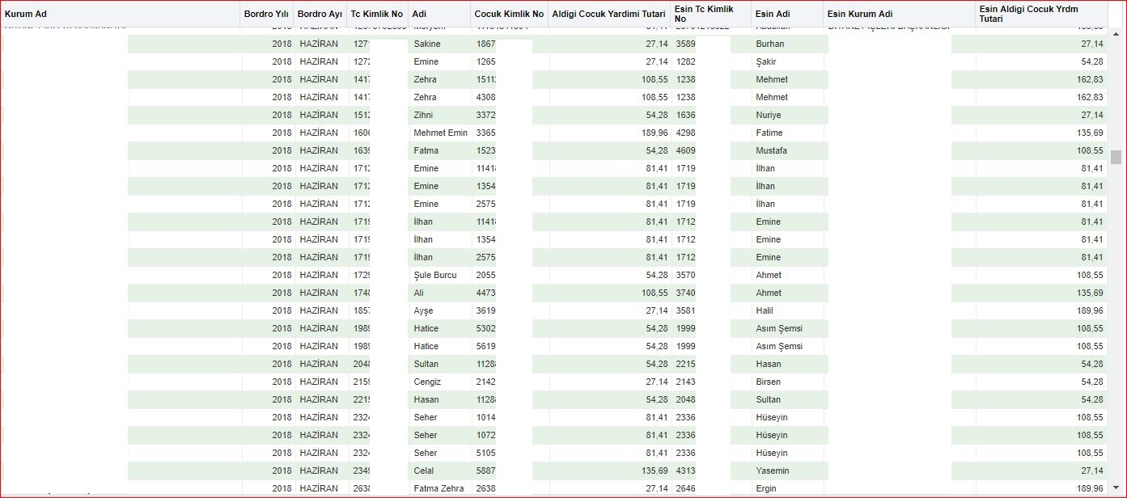
Analysis Scenarios
According to our regulations, additional payments are made to civil servants with children. In this analysis, it is checked whether more than one officer receives payment for the same child.

Slide 32
Analysis Scenarios
As it can be seen in the table, it is presented to the auditors in which institution, how many of the officers and who receive the repeated payment for which children.
As a result of the scenario, in 2018, a total of 1,206,386,01 TL (approximately $ 219,342.91) has been paid to 1,888 employees working in 63 different auditees.

Slide 33
Analysis Scenarios
The analyzes do not show only public losses. A comparison of the data from different sources lists the differences between the current situation and what it should be.
For example, in our regulations, additional payment is made to the staff whose spouse are not working. The situation of the spouse is also determined by the declaration of the personnel.

Slide 34
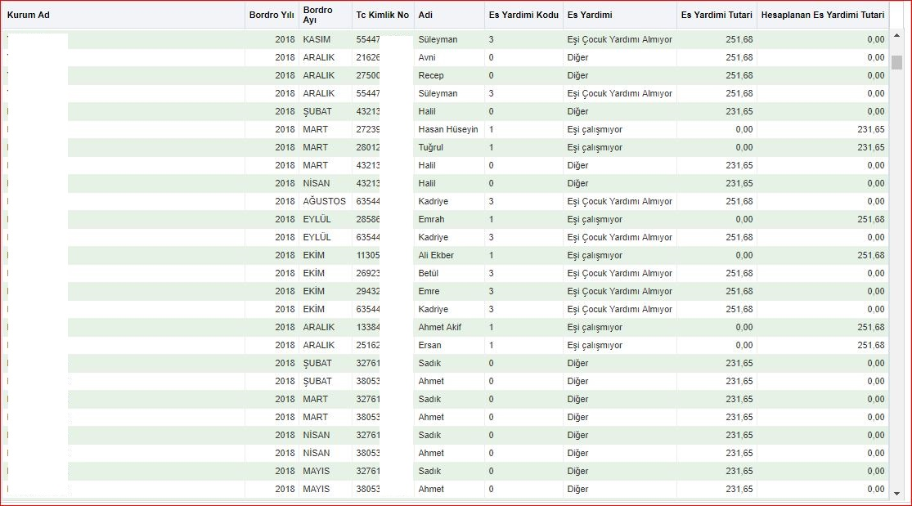
Analysis Scenarios
This analysis lists the personnel who are not paid according to the status of their spouse.

Slide 35
Analysis Scenarios
As a result of this analysis, it was understood that 10,628 people were paid incorrectly in 152 institutions.
As a result of incorrect payment, 4.663 personnel were paid 3.285.014,71TL (approx. 597.275,40 $) more than it should be.
And 5,965 personnel were paid 1,989,914,19 TL (approx. $ 361,802.58) less than it should be.
The net public loss has been determined as 1.295.100,52TL (approx. $ 235.472,82).
As a result of questioning not only over payments but also missing payments, the impressions of the institutions and officers about the auditors become more positive.

Slide 36
Dynamic Analyses
VERA
Also, the auditors are able to run original analysis over VERA and get their results instantly.
With VERA, making more granular analysis of data is provided and it brings more definitive results because the whole data population can be examined.
Determining the accuracy of the information which builds up the data by a computerised system and checking compliance with policies brings a comprehensive approach of testing.

Slide 37
Statistical Sampling Implementations
The volume of the population and the number of items to be examined is continuously increasing, it is very time consuming and not economic to examine all transactions
Effective and efficient execution of an audit is possible with obtaining sufficient appropriate audit evidence applying audit techniques to less than 100% of items within the population
Audit Sampling (ISSAI 1530) -> time and cost saving
Statistical sampling provides information as much as the 100% examination of all items because more careful and intense examination is performed

Slide 38
Statistical Sampling Implementations
Sampling Methods
Transaction Sampling Method
Monetary Unit Sampling Method
Stratified Sampling Method

Slide 39
Transaction Sampling
Transaction Sampling is made without taking into consideration the monetary size of the transactions. Each transaction constituting the population has the same probability of being selected.

Slide 40
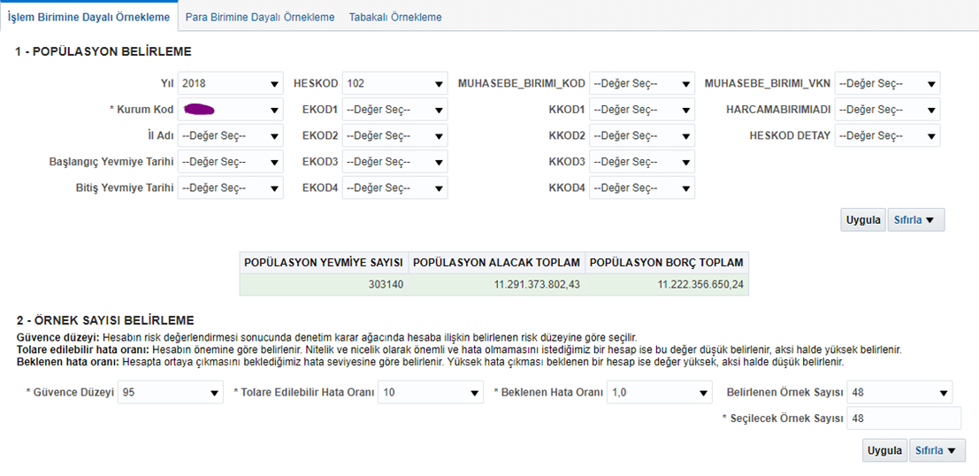
Transaction Sampling
The auditor uses this analysis upon deciding the combination of audit techniques that will ensure achieving the audit objectives.
After identifying the sampling method;
Step 1- Identification of the population from which the samples will be selected
Step 2- Calculating the sample size.
The auditor fills in the assurance level, acceptable error level and expected error rate and the analysis makes calculations based on that information.
(The auditor uses her/his Professional knowledge, experience and judgement for selecting the proper sampling method for the audited population, determining the audit techniques to be applied to selected transactions and evaluating the results.)

Slide 41
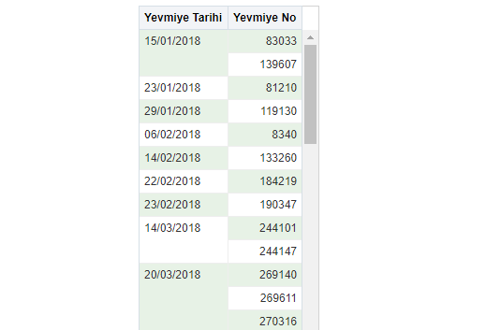
Transaction Sampling
Step 3- Selection of the samples by the tool based on the choices made by the auditor
The dates and the numbers of the selected accounting journal entries are listed
In Transaction Sampling samples are being chosen independent of the monetary size of the transactions. Each transaction constituting the population has the same probability of being selected.
Step 4- For examination of the selected samples the details of the transaction are listed
**The auditor may also choose to use «Monetary Unit Sampling Method» or «Stratified Sampling Method» and follow their steps through the analysis from the start.

Slide 42
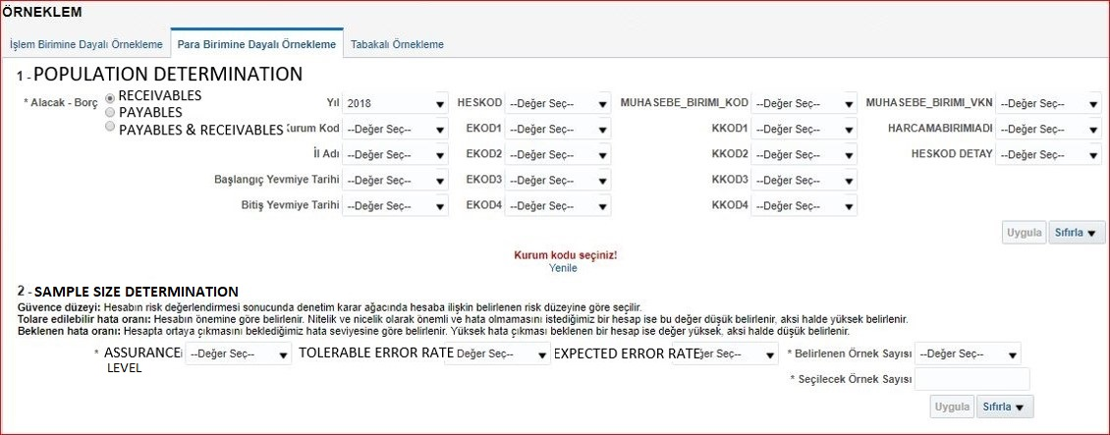
Monetary Unit Sampling
When performing tests of details it may be efficient to identify the sampling unit as the individual monetary units that make up the population. Having selected specific monetary units from within the population, for example, the accounts receivable balance, the auditor may then examine the particular items, for example, individual balances, that contain those monetary units.

Slide 43
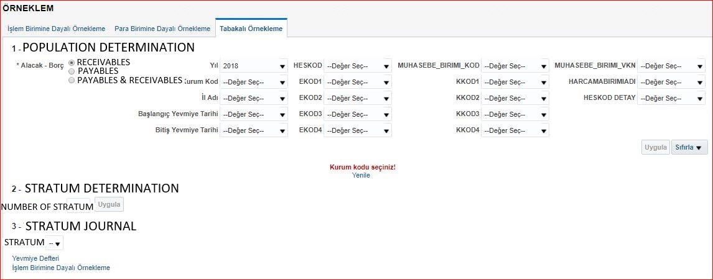
Stratified Sampling
Audit efficiency may be improved if the auditor stratifies a population by dividing it into discrete sub-populations which have an identifying characteristic. The objective of stratification is to reduce the variability of items within each stratum and therefore allow sample size to be reduced without increasing sampling risk.
When performing tests of details, the population is often stratified by monetary value. This allows greater audit effort to be directed to the larger value items, as these items may contain the greatest potential misstatement in terms of overstatement.
Similarly, a population may be stratified according to a particular characteristic that indicates a higher risk of misstatement, for example, when testing the allowance for doubtful accounts in the valuation of accounts receivable, balances may be stratified by age.

Slide 44
Data Security
Data security is provided due to data being stored in central data warehouse.
Access to the data from the desired location can be provided due to access via internet via secure connections.
Auditor computers are used to design queries and show results. The designed query works by the central computer system integrated into the database. In this way, the processing power and capacity of the auditors’ computers becomes insignificant, and even very complex analyzes can be performed on very simple processor computers.

Slide 45
Mobility
Access to the data from the desired location can be provided due to access via internet via secure connections.
Auditor computers are used to design queries and show results. The designed query works by the central computer system integrated into the database. In this way, the processing power and capacity of the auditors’ computers becomes insignificant, and even very complex analyzes can be performed on very simple processor computers.

Slide 46
Low Speed CPUs
Auditor computers are used to design queries and show results. The designed query works by the central computer system integrated into the database. In this way, the processing power and capacity of the auditors’ computers becomes insignificant, and even very complex analyzes can be performed on low speed CPUs.

Slide 47
Actual Results
The analyzes designed by both the auditor and the data analysis group are recorded as queries and the results are displayed on the last data in the database. In this way, it is not necessary to redesign the analyzes in every new data acquisition.
Auditors can share their designed analyzes with colleagues. The shared auditor can see the results of the same analysis for his/her auditee without performing any additional action.

Slide 48
Sharability
Auditors can share their designed analyzes with colleagues. The shared auditor can see the results of the same analysis for his/her auditee without performing any additional action.

Slide 49
Static Analyzes Save Time
While the difficulty of preparing the analyzes varies between 2 minutes and 2-3 hours, it takes an average of 10 minutes for an analysis to be prepared by the expert. There are about 300 scenarios.
As a result of the presentation of 300 analyzes, an audit team saves 3000 minutes (50 hours) for an auditee. Considering the average of 2 auditees per team, one team's annual time saving will be 100 audit hours (approximately 12 days).
So, a 10 minute work of data analyzes group auditor saves approximately 1500 minute of financial auditor. (for 75 audit team and 2 auditee per audit team)
As the calculation is made by optimum times and conditions, in real world the gain can be much more.

Slide 50
Vision
Our Group also carries out studies to increase the awareness and knowledge level of the auditor about big data.
2 important audit topics that we are currently working on are as follows:
Data Analysis for Audit of Sustainable Development Goals (SDGs)
Preparedness Audit on Geographic information systems (GIS)

Slide 51
Data Analysis for SDGs
Preparedness audit on SDGs is continuing.
Verification of the results of SDG target indicators produced by the Turkish Statistical Institute is planned.

Slide 52
Audit on Implementation of SDGs

Slide 53
Preparedness Audit on GIS
Geographic information system (GIS) is a powerful tool to analyse and present spatial and geographical data. GIS could be a valuable tool in analysing the regional aspects and differences of environmental problems, as well as presenting them in a visual way. (ISSAI 5110 – 65)

Slide 54
Thank you for your attention…

