Slide 1
TCA AUDIT MANAGEMENT SYSTEM (SAYCAP)

Slide 2
SayCap is an Audit Management System by which entire audit cycle proceeds step by step.
It is appropriate for TCA’s requirements and audit processes.
It is adaptable and flexible to changing legal regulations, audit standards or needs.

Slide 3
SayCap helps TCA to;
Increase the audit effectiveness,
Strengthen audit management by using IT,
Develope an Audit Management System for planning, documenting and analyzing the audits,
Conduct the procedures of planning, executing, reporting and quality control phases of the audits in an IT Environment,
Consolidate the audit results,
Support TCA to carry out the overall reporting responsibilities on time.

Slide 4
Regularity Audits
Performance Audits
State Economic Enterprises Audits
by TCA are performed by means of SayCap.

Slide 5
The main screen of SayCap

Slide 6
PROGRAMMING

Slide 7
PROGRAMMING
Audit area of TCA is followed up by Audit Supporting Group 1 in ‘Institution’ sub-module. Related data's concerning public administrations are input into this sub-module when a public administration is established or shut down.

Slide 8
PROGRAMMING

Slide 9
PROGRAMMING
At the very beginning of the audit period, risk evaluations of public administrations are also made by headships of audit groups and Audit Supporting Group 1 in this module. Heads of audit groups and head of Audit Supporting Group 1 input their assessments and opinion into the ‘Institution Risk Assessment’ sub-module.
The Board of Auditing, Planning and Coordination prepare audit strategic plans and annual audit programs in line with the risk analysis in consideration with the expectations of the Turkish Grand National Assembly, the public and the public administrations subject to audit.

Slide 10
PROGRAMMING

Slide 11
Group Resources plannıng
This module is used by the heads of groups to make planning for the auditees, auditors and time resources.

Slide 12
Group Resources plannıng

Slide 13
Group Resources plannıng
Heads of groups determine firstly how much time they will need for the auditees and compare this period with the total auditor source available by using ‘Periodical Audit Planning’ sub-module.

Slide 14
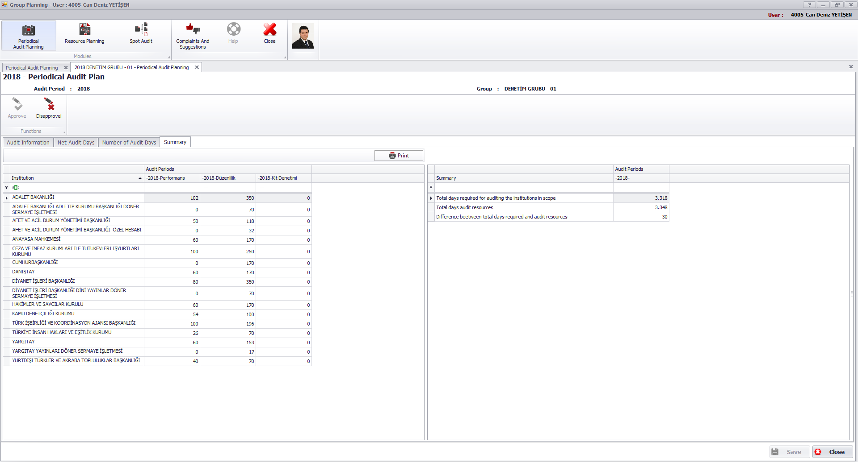
Group Resources plannıng

Slide 15
Group Resources plannıng
Secondly, audit teams are formed for each audit; team leaders and auditors are determined by using ‘Resource Planning’ sub-module.

Slide 16
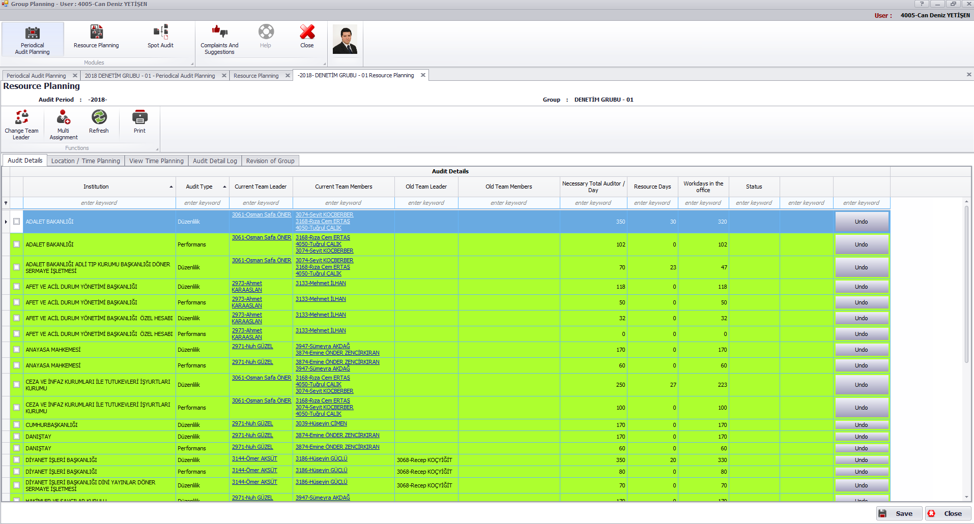
Group Resources plannıng

Slide 17
Group Resources plannıng
It is also determined in this sub-module that the audit teams will carry out auditing on which dates and where they are located (at the center or on the spot).

Slide 18
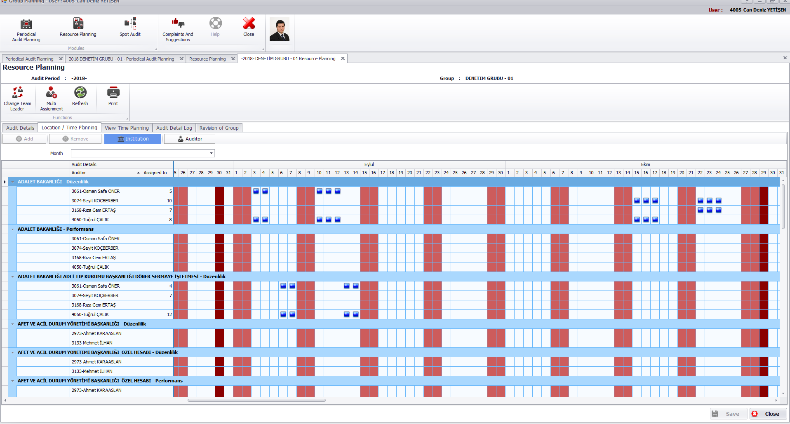
Group Resources plannıng

Slide 19
plannıng
The planning module consists of 8 sub-modules:
Understanding Auditee – Planning
Understanding Auditee – Fieldwork
Accounting Area & Materiality Determination
Risk Assessment
Test of Controls
Assessment of Planning Studies
Audit Plan
Audit Program

Slide 20
plannıng

Slide 21
UnderstandIng AudItee – PlannIng
The first step of planning module is planning of getting to know the entity.
Like the other sub-planning steps at the planning module (Identifying the Account Areas and Materiality and Audit Program) the team leader is authorized at this step.
Team leader assigns the procedures to the auditors. These procedures may be mandatory or optional. Team leader may produce new procedures or may use procedures which exist in the procedure pool.

Slide 22
UnderstandIng AudItee – PlannIng

Slide 23
UnderstandIng AudItee – PlannIng

Slide 24
UnderstandIng AudItee - FIELDWORK
At Planning and Execution modules of SayCap auditors record their all works by using procedures.
All procedures contains working papers.
Auditors can also upload files (related files, reports etc).
In contrast to the procedures in other steps, auditors can also add risks (inherent or control risk) at this step.
Besides, auditors can also add findings into the procedures.
All procedures are completed by auditors and approved by the team leader.

Slide 25
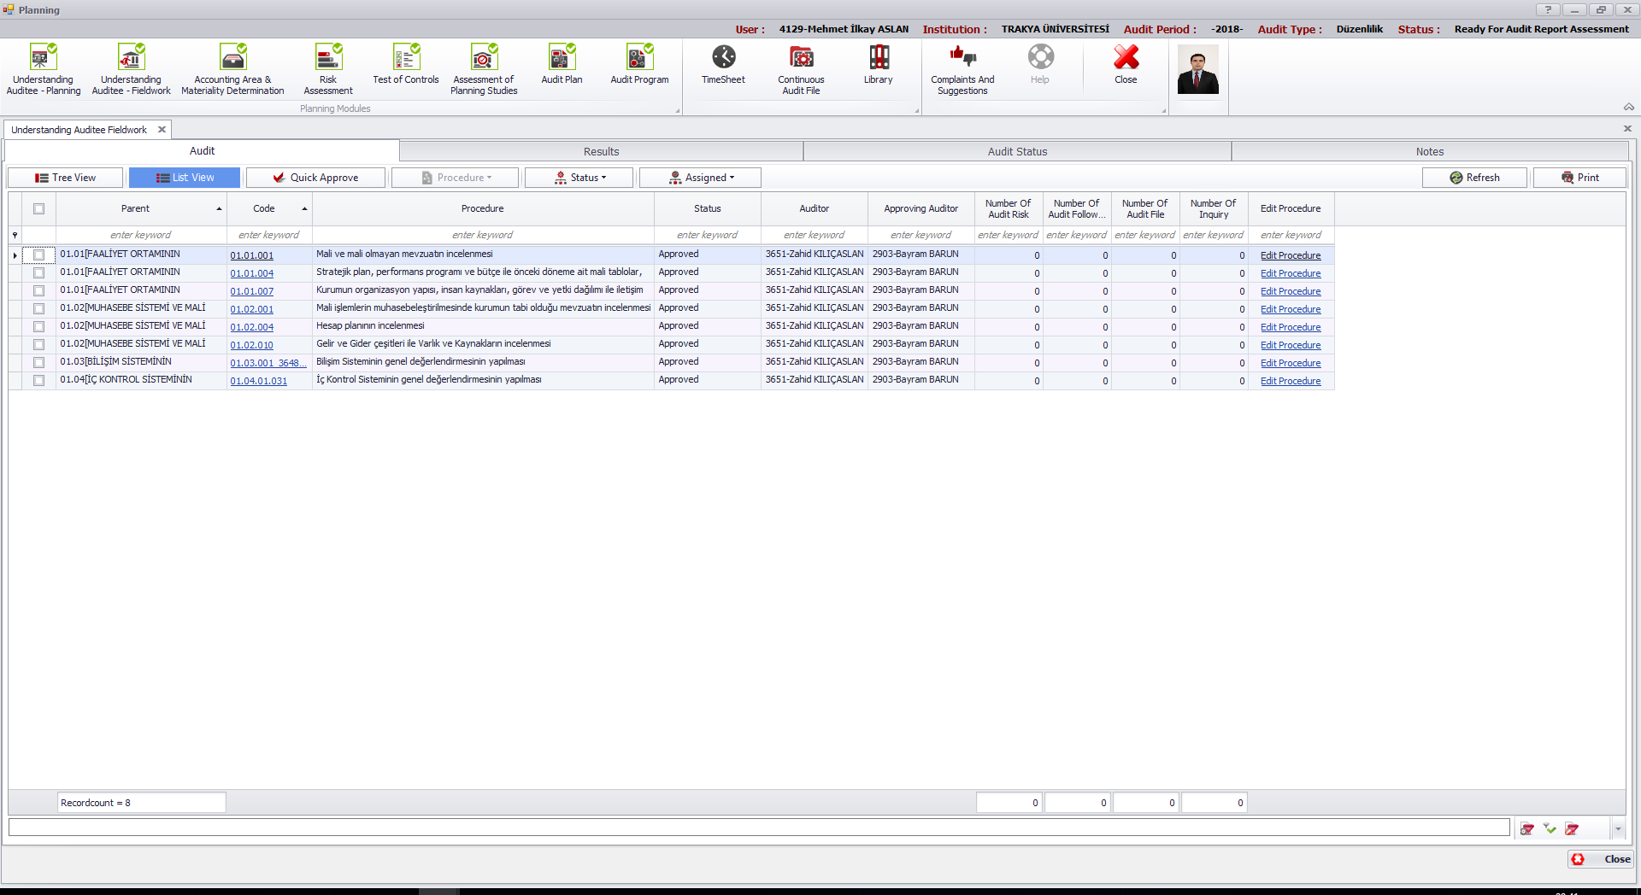
UnderstandIng AudItee - FIELDWORK

Slide 26
UnderstandIng AudItee - FIELDWORK

Slide 27
UnderstandIng AudItee - FIELDWORK
A finding can be added to a procedure by an auditor when he fills and saves the necessary information which are shown on this screen.
Two points are especially important.
Firstly, expected amount of error, topic of the finding and related account area must be determined by the auditor.
Secondly, if any suspect about public loss exist, then the inquiry box must be filled by auditor to start working for Judicial Report.

Slide 28
UnderstandIng AudItee - FIELDWORK

Slide 29
AccountIng Area & MaterIalIty DetermInatIon
Team leader is authorized at this level.
He determines planning stage materiality level and account areas.
He assigns internal control procedures about important account areas to the auditors.

Slide 30
AccountIng Area & MaterIalIty DetermInatIon

Slide 31
RIsk Assessment
The risks which are identified at ‘Understanding Auditee – Fieldwork’ sub-module are associated with important account areas in this step.
Then the risk level on the basis of the important account areas is determined.

Slide 32
RIsk Assessment

Slide 33
Test Of Controls
The studies on the procedures about internal control tests of important account areas are completed by auditors and approved by team leader.
The working papers of these procedures must contain sufficient information about whether the internal controls about important account areas works or not.

Slide 34
Test Of Controls

Slide 35
Assessment of PlannIng StudIes
In this step, assurance factors of account areas and inspection methods of them are determined and recorded.

Slide 36
Assessment of PlannIng StudIes

Slide 37
AudIt Plan
Audit Plan is a summary of the all works till this step in the ‘Planning’ module.
In Audit Plans all procedures are completed by team leaders and approved by the head of groups.
When approvals are completed, audit plans are also approved by head of departments.

Slide 38
AudIt Plan

Slide 39
AudIt Program
Produced, optional and mandatory procedures which will be used in the ‘Execution’ module are assigned by the team leader to the auditors.

Slide 40
AudIt Program

Slide 41
EXECUTION
The execution module consists of 4 sub-modules:
Fieldwork
Inform
Hot Review
Inquiry

Slide 42
EXECUTION

Slide 43
fıeld work
Auditors;
Fill their working papers,
Add findings,
And complete their procedures at this stage.

Slide 44
fıeld work

Slide 45
Hot Revıew
First and Second Level Review;
First level review procedures are completed by team leaders and approved by head of groups,
Second level review procedures are completed and approved by head of groups.

Slide 46
Hot Revıew

Slide 47
ınquıry
The inquiry must contain;
Exact amount of public loss,
Names and titles of responsible people,
The cause and effect relationship between asserted public loss and acts which violate the legislation.
When these information are completely written by auditors and all inquiries are completed, ‘Inquiry’ sub-module can be closed by team leader to start working on judicial report.
Works on inquiry and judicial report sub-modules are independent from other modules and sub-modules.

Slide 48
ınquıry

Slide 49
REPORTING
The reporting module consists of 4 sub-modules:
Draft Report Assessment
Audit Report Assessment
TCA Draft Report Assessment
TCA Report Final
All findings about public administration which may come from planning or execution modules are consolidated in this module.
Works on the sub-modules of ‘Reporting’ module is proceeds in accordance with the provisions of Code of Turkish Court of Accounts and TCA's reporting guidelines.
Sub-modules of reporting module are completed by head of groups and approved by head of departments.

Slide 50
REPORTING

Slide 51
QUALITY CONTROL & MONITORING

Slide 52
MANAGEMENT TOOLS
The management tools module consists of 12 sub-modules:
Audit Department Head Control
Auditor Report
Institution Report
Audit and Results Report
Audit Follow Up Report
Procedure Report
Inform Report
Announcement
Revision Report
User Log
Admin Report
Admin Panel

Slide 53
MANAGEMENT TOOLS

Slide 54
AudIt Department Head Control
At various stages of the audit, the head of departments need to check and approve processes.
In these cases, ‘Audit Department Head Control’ sub-module is used to make the necessary approvals.
The head of departments are able to approve;
Audit plan reports,
Commissions,
Commission reports,
Audit reports
for the audits that are associated to them.

Slide 55
AudIt Department Head Control

Slide 56
AudItOR REPORT
In ‘Auditor Report’ sub-module, information regarding auditors can be accessed according to the audit period.

Slide 57
AudItOR REPORT

Slide 58
InstItutIon Report
In ‘Institution Report’ sub-module, information regarding audits can be accessed according to the audit period.

Slide 59
InstItutIon Report

Slide 60
AudIt Follow Up Report
In ‘Auditor Follow Up Report’ sub-module, various information regarding audits can be accessed for a particular year.
For example:
Auditee budget type
Audit type
Audit opinion
Various information about audit findings

Slide 61
AudIt Follow Up Report

Slide 62
PROCEDURE REPORT
In ‘Procedure Report’ sub-module, the procedures used by the auditors during the audits can be achieved.
Each procedure used by auditors is stored in the system.
Statistical information on procedures created by auditors and the mandatory procedures assigned by the presidency can be reached in this sub-module.

Slide 63
PROCEDURE REPORT

Slide 64
USER LOG
In ‘User Log’ sub-module, data on user entries are achieved.

Slide 65
USER LOG

Slide 66
SAYCAP DASHBOARD
SayCap Dashboard is a web based module prepared to provide summary information to president, deputy presidents and head of departments about the data and statistics produced in SayCap.

Slide 67
SAYCAP DASHBOARD

Slide 68
SAYCAP DASHBOARD

Slide 69
SETTINGS
The ‘Settings’ module consists of 5 sub-modules:
Library Definition
User
User Group
Audit Pool
Parameters

Slide 70
SETTINGS
The ‘Settings’ module is only used by system administrators. Data can be input only by admins.
Settings contains data's about users, user groups, audit pool and auditing parameters.

Slide 71
SETTINGS

Slide 72
SETTINGS

Slide 73
SETTINGS

Slide 74
SETTINGS

Slide 75
SETTINGS

Slide 76
SETTINGS

Slide 77
Thank you for your attention…

