Slide 1

INTERNATIONAL STANDARDS
FOR ENTERPRISE RISK MANAGEMENT AND INTERNAL CONTROLS

Slide 2
AGENDA
Internal Control (COSO Internal Control-Integrated Framework 2013)
Risk Management Definitions According to the Standards
Risk Management Standards
  ISO
  COBIT
  COSO
Differences Between COSO’s Internal Control and ERM

Slide 3
WHAT IS COSO?
The Committee of Sponsoring Organizations of the Treadway Commission COSO) is a joint initiative of the five private sector organizations shown below and dedicated to providing thought leadership through the development of frameworks and guidance on enterprise risk management, internal control and fraud deterrence.
  American Accounting Association
  American Institute of Certified Public Accountants
  Financial Executives International
  The Association of Accountants and Financial Professionals in Business
  The Institute of Internal Auditors

Slide 4

INTERNATIONAL STANDARDS FOR INTERNAL CONTROL
COSO’s internal control framework is recognized globally and it has stood the test of time.
There was an INTOSAI Guideline for Internal Control Standards for the Public Sector, however it has been withdrawn and there is no replacement so far.
COSO publications regarding Internal Control:
Regarding Internal Control,
  In 1992, COSO published Internal Control — Integrated Framework.
  This framework was revised and reissued in May 2013. Effective December 15, 2014, the 1992 framework is superseded and no longer available.
  Internal Control — Integrated Framework: Executive Summary, Framework and Appendices, and Illustrative Tools for Assessing Effectiveness of a System of Internal Control (3 volume set)
  Internal Control — Integrated Framework, Internal Control Over External Financial Reporting: A Compendium of Approaches and Examples

Slide 5
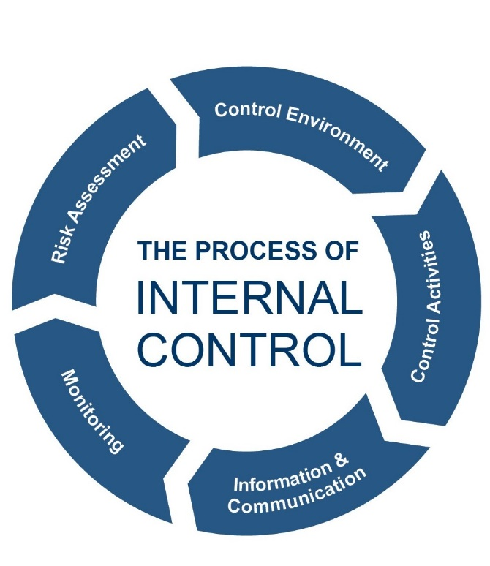
INTERNAL CONTROL-DEFINITION
A process, effected by an entity’s board of directors, management, and other personnel, designed to provide reasonable assurance regarding the achievement of objectives relating to operations, reporting, and compliance.

Slide 6
UNDERSTANDING INTERNAL CONTROL
Internal control is:
  Geared to the achievement of objectives
  A process consisting of ongoing tasks and activities
  Effected by people
  Able to provide reasonable assurance (not absolute assurance)
  Adaptable to the entity structure

Slide 7
WHAT CAN BE EXPECTED FROM INTERNAL CONTROL?
Internal Control aims at providing reasonable assurance regarding the achievement of 3 objectives:
  Operations Objectives
  Reporting Objectives
  Compliance Objectives
These objectives are pre-set within organizations along with their missions, visions and strategies, which are preconditions for an internal control system.

Slide 8
OBJECTIVES
Mission-Vision
Strategic Goals
Entity Level Objectives
Compliance Objectives
Operations Objectives
Reporting Objectives
Sub-Objectives
Sub-Objectives
Sub-Objectives
An example of objectives flow
Organizations’ functions departments, processes or divisions can also be included in the flow

Slide 9
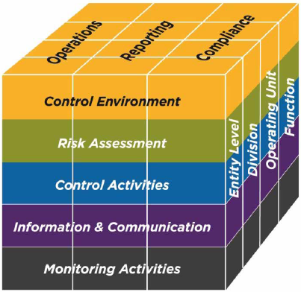
COMPONENTS OF INTERNAL CONTROL
Components shown below are requirements to achieve the objectives:
  Control Environment,
  Risk Assessment,
  Control Activities,
  Information and Communication,
  Monitoring Activities

Slide 10
COMPONENTS OF IC
CONTROL ENVIRONMENT | RISK ASSESSMENT | CONTROL ACTIVITIES | INFORMATION AND COMMUNICATION | MONITORING ACTIVITIES
The set of standards, processes, structures that provide the basis for carrying out IC across the organization. | Dynamic and iterative process. Consists of identifying, analyzing risks impairing the objectives and responding them | Actions established by policies and procedures to help ensure that management directives to mitigate risks. | Necessary for the entity to carryout internal control responsibilities is support of its objectives. | Ongoing evaluations, separate evaluations or combination of the two.
The management establishes the tone at the top regarding the importance of IC. | Management should consider possible changes in the internal and external environment related to its objectives. | Control activities are performed at all levels of the entity and at various stages within business processes. | Provides organization with the information needed to carry out day-to-day controls. | To ascertain whether each of the 5 components is present functioning, and operating together.

Slide 11
COMPONENTS AND PRINCIPLES OF INTERNAL CONTROL
CONTROL ENVIRONMENT | RISK ASSESSMENT | CONTROL ACTIVITIES | INFORMATION, COMMUNICATION | MONITORING
1. The organization demonstrates a commitment to integrity and ethical vaues | 6. The organization specifies objectives with sufficient clarity to enable the identification and assessment of risks relating to objectives | 10. The organization selects and develops control activities that contribute to the mitigation of risks to the achievement of objectives to acceptable levels | 13. The organization obtains or generates and uses relevant, quality information to support the functioning of internal control | 16. . The organization selects, develops and performs ongoing and/or separate evaluations to ascertain whether the components of internal control are present and functioning
2. The board of directors demonstrates independence from management and exercises oversight of the development and performance of internal control | 7. The organization identifies risks to the achievement of its objectives across the entity and analyzes risks as a basis for determining how the risks should be managed | 11. The organization selects and develops general control activities over technology to support the achievement of objectives | 14. The organization internally communicates information, including objectives and responsibilities for internal control, necessary to support the functioning of internal control | 17. The organization evaluates and communicates internal control deficiencies in a timely manner to those parties responsible for taking corrective action, including senior management and the board of directors, as appropriate
3.Management establishes, with board oversight, structures, reporting lines, appropriate authorities and responsibilities in the pursuit of objectives | 8. The organization considers the potential for fraud in assessing risks to the achievement of objectives | 12. The organization deploys control activities through policies that establish what is expected and procedures that put policies into action | 15. The organization communicates with external parties regarding matters affecting the functioning of internal control
4. The organization demonstrates a commitment to attract, develop, and retain competent individuals in alignment with objectives | 9. The organization identifies and assesses changes that could significantly impact the system of internal control
5. The organization holds individuals accountable for their internal control responsibilities in the pursuit of objectives

Slide 12
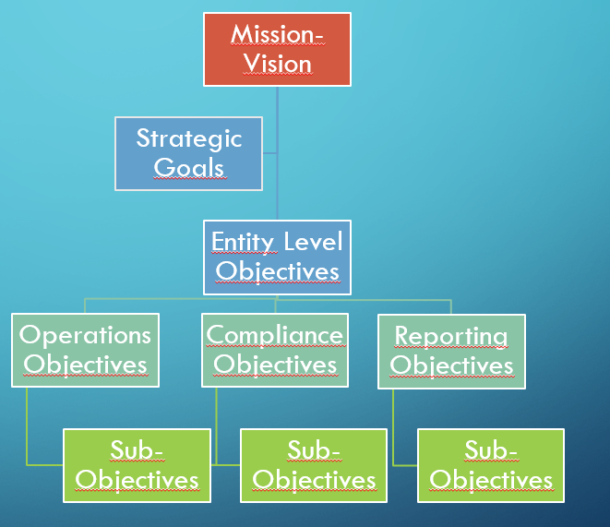
SETTING OBJECTIVES (PRINCIPLE 6)
Setting, mission, vision, strategic aims and entity level objectives out are not part of internal control but the management role.
Specifying objectives is part of internal control
What does specifying objectives mean?
  Principle 6 explains how to do it.
    Alignment between established vision, objectives and applicable legislation
    Articulation of objectives using terms that are specific, measurable or observable, attainable, relevant and time-bound.
    Grouping objectives within broad categories at all level

Slide 13
Identifying AND ANALYZING RISK IN TERMS OF INTERNAL CONTROL (Prıncıple 7)
Identifying risks;
  Risk is ;“The possibility that events will occur and affect the achievement of strategy and business objectives.”
    Analyze internal and external factors
    Risk identification must be comprehensive
    Includes all levels, stakeholders, internal and external factors
    Considers factors that influence the severity, velocity, likelihood ,and persistence of risk etc.
Estimating significance of risks identified;
    Impact
      Result or effect of a risk
    Likelihood
      The possibility of a risk occuring
Determining how to respond risks

Slide 14
PROPER RISK IDENTIFICATION
Example 1:
  Some auditees might be unwilling to follow audit recommendations, which affects the TCA’s contribution to a better financial management system
    “The possibility that events will occur and affect the achievement of strategy and business objectives.”
      Event: Unwillingness of auditees to follow the audit recommendation
      Affected strategy or business objective: TCA’s contribution to a better financial management system (one of the strategic goals)
      Possibility: To be assessed in the risk assessment component of IC

Slide 15
PROPER RISK IDENTIFICATION
Example 2:
  Purchasing department might fail to follow procurement procedures resulting in public loss
    Event: Failure to follow procurement procedures
    Affected business objective: Efficient procurement activities (finding best price)
    Possibility: To be assessed in the risk assessment component of IC

Slide 16
RISK RESPONSE (PRINCIPLE 7)
Principle 7
  Acceptance
  Avoidance
  Reduction
  Sharing
Selected Responses
  Part of management process
Example 1
  Some auditees might be unwilling to follow audit recommendations, which affects the TCA’s contribution to a better financial management system
  Risk Response: Since the possibility of the risk realization is low and the estimated rate of auditees who might not follow audit recommondation is below the risk tolerance, the management chooses to accept this risk. (management tolerates it, no control over the risk.)
Example 2:
  Purchasing department might fail to follow procurement procedures resulting in public loss
  Since the impact of risk on business objectives and the organization’s reputation is high, and the risk apetite about public loss is low, the management choose risk reduction, and to develop effective controls.

Slide 17
RISK APETITE AND RISK TOLERANCE
Concepts of ERM
To be explained in the second part of presentation

Slide 18
SELECTING AND DEVELOPING CONTROL ACTIVITIES (PRINCIPLE 10)
Integrates with risk assessment
Considers Entity-Specific Factors
Determines Relevant Business Processes
Evaluates a Mix of Control Activity Types
  Authorizations and Approvals
  Verifications
  Physical Controls
  Supervisory Controls
  Technology Used to Automate Control Activities
  Segregating Duties

Slide 19
CONDUCTING ONGOING AND/OR SEPERATE EVALUATIONS (Prıncıple 16)
Considers a mix of ongoing and seperate evaluations
Establish baseline understanding
Uses knowledgeable personnel
Integrates with business processes
Adjust scope and frequency
Objectively evaluates

Slide 20

STANDARDS FOR ENTERPRISE RISK MANAGEMENT

Slide 21
RISK AND RISK MANAGEMENT
Risk is,
  “The possibility that events will occur and affect the achievement of strategy and business objectives.” (COSO ERM – Integrating with Strategy and Performance 2017)
  Effect of uncertainty on objectives (ISO 31 000)
COSO defines ERM as follows:
  The culture, capabilities, and practices, integrated with strategy-setting and its performance, that organizations rely on to manage risk in creating, preserving, and realizing value.
ISO defines risk management as follows:
  Coordinated activities to direct and control an organization with regard to risk

Slide 22
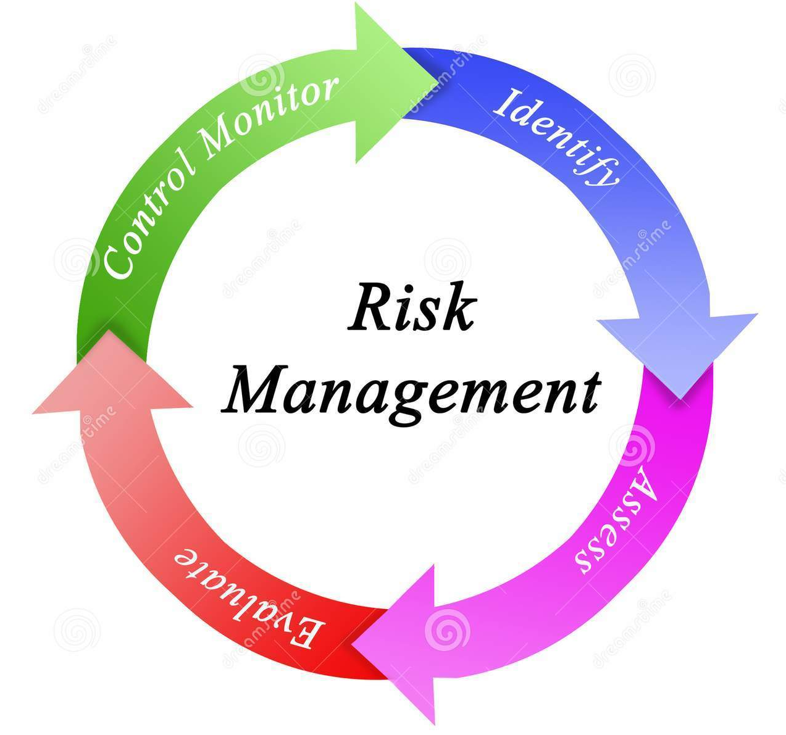
RISK MANAGEMENT STANDARDS
Risk management standards are often designed and created by a number of agencies and they aim at designing a risk management process through;
  Identifying and assessing risks,
  Promoting the mitigation of effects of risks,
  Showcasing the best practices,
  Providing a worldwide consensus.

Slide 23
internationally recognized risk management frameworks (Commonly used)
1) ISO International Standard for Risk Management (31 000: 2018),
2) COBIT 2019
3) COSO ERM – Integrated Framework (2004),
4) COSO ERM Integrating with Strategy and Performance Framework (2017)

Slide 24
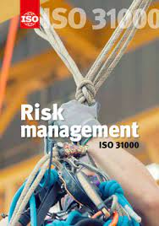
ISO International Standard for Risk Management (31 000: 2018) (31 000: 2018)
The Purpose of Risk Management in ISO:
  Creating and protecting value,
  Improving performance,
  Encouraging innovation,
  Supporting of achieving of objectives.

Slide 25
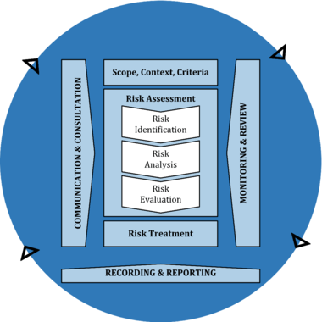
RISK MANAGEMENT PRocess IN ISO
Managing risk is based on the principles, framework and process outlined in ISO 31 000.
Risk Management Process in ISO

Slide 26
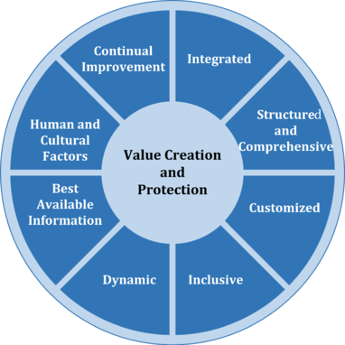
RISK MANAGEMENT PRINCIPLES IN ISO
Integrated
Structered and Comprehensive
Customized
Inclusive
Dynamic
Best Available Informantion
Human and Cultural Factors
Continual Improvement

Slide 27
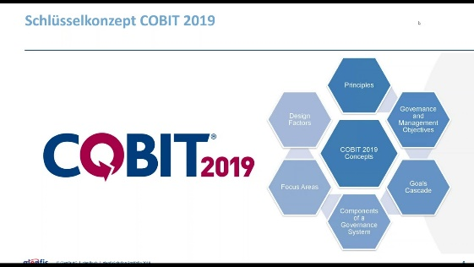
Control Objectives for Information and Related Technology
Registered trademark of ISACA
A main framework for corporate IT governance and management
Covers the activities and responsibilities of both the IT function and non-IT business functions
Deals with risk management in the IT domain and, specifically, the governance and management of enterprise IT.

Slide 28
COBIT 2019
Two perspectives on how to use COBIT 5 in a risk context:
Risk function perspective—Describes what is needed in an enterprise to build and sustain efficient and effective core risk governance and management activities
Risk management perspective—Describes how the core risk management process of identifying, analyzing, responding to and reporting on risk can be assisted by the COBIT 5 enablers

Slide 29
COSO ERM
Publications Regarding Regarding ERM
  In 2004, COSO issued Enterprise Risk Management — Integrated Framework.
  In 2017 of “Enterprise Risk Management–Integrating with Strategy and Performance,”

Slide 30
WHAT IS THE ROLE AND OBJECTIVES OF ERM?
Creating and protecting value,
Meeting mission and achieving strategies and business objectives,
Enhanced performance of the organization,
Improved decision making,
Improved performance,
Identifying, assessing and managing the risks.
An integral part of the strategy selection process.

Slide 31
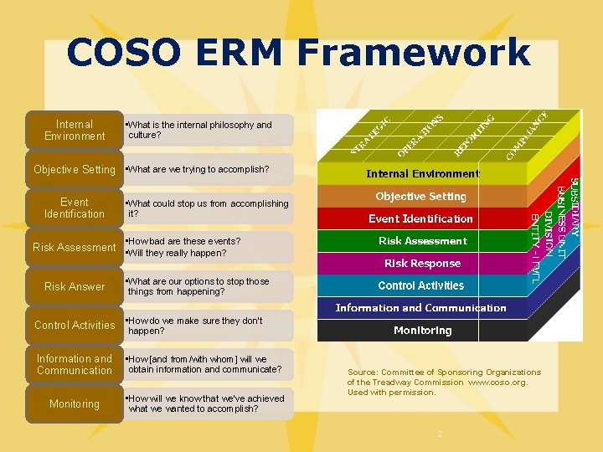
COSO ERM 2004
COSO ERM 2004
  8 components
    Internal Environment
    Objective Setting
    Event Identificitaion
    Risk Assessment
    Risk Response
    Control Activities
    Information and Communication
    Monitoring
  4 categories of objectives
  Many organizations found it complex and hard to understand

Slide 32
COSO ERM 2017
COSO ERM 2017
  COSO took criticism into account and updated the previous one,
  5 components
  Principle based (20 principles)
  Promotes to integrate ERM practices throughout an organization,
  Aligning with strategy setting and performance,
  Focuses on improving decision-making in governance, strategy, objective setting, and day to day operations.
  Allocating resources according to predetermined principles

Slide 33
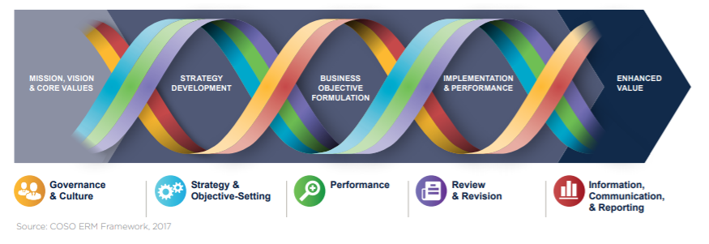
COSO ERM 2017
The COSO ERM framework comprises five interrelated components:
  1) Governance and culture,
  2) Strategy and objective setting,
  3) Performance,
  4) Review and revision and
  5) Information, communication, and reporting.

Slide 34
COMPONENTS OF ERM
Governance and Culture | Strategy and Objective Setting | Performance | Review and Revision | Information, Communication, and Reporting
Form a basis for all other components. | ERM is integrated into the entity’s strategic plan through the process of setting strategy and business objectives. | An organization identifies and assesses risks that may affect an entity’s ability to achieve its stratgey and business objectives. | Revision of capabilities and practices, and the entity’s performance relative to its targets. | Communication is the continual, iterative process of obtaining information and sharing it throughout the entity.
Governance sets the entity’s tone, reinforcing the importance of ERM, and establishing oversight responsibilities for it. | An organization sets its risk apetite in conjuction with strategy-setting. | It prioritizes risk according to their severity and considering the risk apetite. | The question; ‘ How well has ERM increased value over time?’ | Management uses relevant information from both internal and external sources to support ERM.
Culture is reflected in decision-making | The business objectives allow strategy to be put into practice and shape the entity’s day-to-day operations and priorities. | It selects risk responses and monitors performance for change. |  | The organization leverages IT systems to capture, process, and manage data and information.

Slide 35
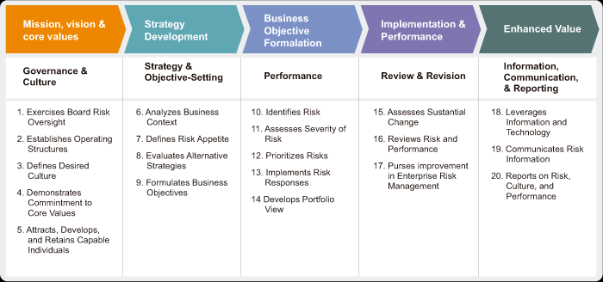
COMPONENTS AND PRINCIPLES OF ERM IN COSO

Slide 36
RISK APETITE (PRINCIPLE 7)
Risk apetite is the types and amount of risk, the management is willing to accept in its pursuit of value (in short; acceptable amount of risks)
There is no universal risk apetite
  It can be defined on the level of
    Strategy and business objective that align with the mission and vision
    Business objective categories
    Performance targets of the entity
How to define?
  Discussions
  Reviewing past
  Internal and external stakeholder expectations

Slide 37
OBJECTIVE SETTING (PRINCIPLE 8)
Objective setting is a function of managements (not internal control).
ERM helps managements in considering risks in the process of evaluating alternative strategies for strategic plans.
  Different strategies will expose an entity to different risks or different amounts of similar risks.
  The identified risks collectively form a risk profile for each option, that is, different strategies yield different risk profiles.
  Management use these risk profiles when deciding on the best strategy to adopt.

Slide 38
FORMULATING BUSINESS OBJECTIVE (PRINCIPLE 9)
Develops objectives that are spesific, measurable or observable, attainable and relevant (remember these ojectives in IC)
Business objectives may cascade throughout the entity (divisions, operating units, functions)
  Financial
  Operational,
  Compliance,
  Efficiency
  Innovation,
  Customer espirations etc.

Slide 39
IDENTIFYING RISK (PRINCIPLE 10)
Strategy
Entity Business Objective 1
Business Objective 1
Business Objective 2
Entity Business Objective 2
Business Objective 3
Risk 1
Risk 3
Risk 4
Risk 2
The same principles of identification risks in IC.
Using a Risk Inventory
  A list of all risk the entity faces.
Risks impact at Different Levels

Slide 40
ASSESSING SEVERITY OF RISK (PRINCIPLE 11)
Impact
  Result or effect of a risk
Likelihood
  The possibility of a risk occuring
Risk Assessment Result
  High-Moderate-Low

Slide 41
PRIORITIZING RISKS (PRINCIPLE 12) and rısk response (prıncıple 13)
Management’s function
Many criteria
  Adaptibilty
  Complexity
  Velocity,
  Persistence,
  Recovery.
Risk response;
  Accept
  Avoid
  Pursue
  Reduce
  Share

Slide 42
EXAMPLE
RISK APETITE : Low risk appetite for two strategic goals
STRATEGY : TCA’s contribution to a better financial management system (one of the strategic goals)
  RISK : Some auditees might be unwilling to follow audit recommendations, which affects the TCA’s contribution to a better financial management system
RISK SEVERITY :
  Likeliood :Low
  Impact :High
  Severity : Moderate
RISK PRIORITY : One of the most important risk in the portolio
RISK RESPONSE : Reduce
CONTROLS : Function of IC

Slide 43
Standards and Poor’s (S&P) APPROACH
Standards and Poor’s (S&P) has added ERM component into their credit rating analysis process since 2005.
The ERM Evaluation is not a credit rating. It is a stand-alone, on-request service and separate from credit ratings.
“ If a company focus is shifting from a “cost/benefit” line of thought to a “risk/reward” approach, an ERM Evaluation may be a helpful tool in responding to current and future challenges. ”

Slide 44
WHAT IS DIFFERENCE BETWEEN ERM AND IC?
ERM is different than, but related to, internal controls.
But ERM also includes certain concepts that are not considered within internal control. For example, concepts of risk appetite, tolerance, strategy, and business objectives are set within ERM, but are viewed as preconditions of internal control.
ERM is more closely aligned with strategy than internal control.

Slide 45
IC AND ERM DIFFERENCES
Mission-Vision
Strategic Goals
Entity Level Objectives
Compliance Objectives
Operations Objectives
Reporting Objectives
Sub-Objectives
Sub-Objectives
Sub-Objectives
Making strategic decisions, like setting entity level objectives, is not part of internal control. (What is that part of?)
Setting risk appetite and risk tolerance are not part of internal control.
Selecting and developing controls are part of internal control. However, choosing risk response to address specific risks is not part of internal control.

Slide 46
THANK YOU!

